Slide 1
UNIT 4
INTERACTION WITH DATABASE

Slide 2
Databases are critical for storing and processing data even if you consider a powerful programming language like Python.
A database is basically a collection of structured data in such a way that it can easily be retrieved, managed and accessed in various ways. One of the simplest forms of databases is a text database.

Slide 3
Relational databases are the most popular database system which includes the following:
MySQL
Oracle Database
SQL server
Sybase
Informix
IBM db2
NO SQL

Slide 4
How does Python connect to a database?
It is very simple to connect Python with the database. Refer the below image which illustrates a Python connection with the database where how a connection request is sent to MySQL connector Python, gets accepted from the database and cursor is executed with result data.

Slide 5
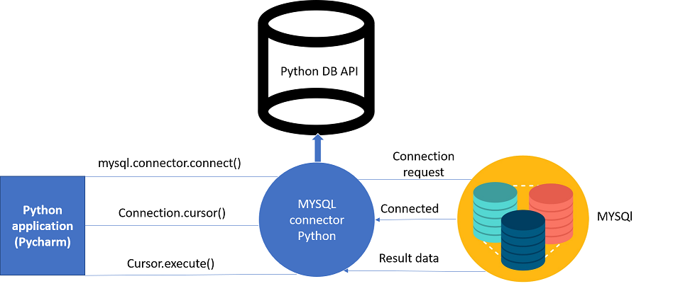

Slide 6
Before proceeding you should make sure you have MySQL db installed on your computer. Refer the below commands for installing MySQL in command prompt and pycharm:
Using Pip:
Command:
pip install mysql-connector
Using Pycharm
Command:
import mysql.connector

Slide 7
The parameters required to connect to the database:
Username- It is simply the username you give to work MySQL server with, the Default username is root.
Password- Password is given by the user when you have installed the MySQL database. I am giving password here as ‘password123’
Host Name- This basically is the server name or IP address on which your MySQL is running, If it is a ‘localhost’, then your IP address is 127.0.0.0

Slide 8
Example:
import mysql.connector
mydb=mysql.connector.connect(host="localhost",user="root",passwd="")
// I have used 'host','username','password'
print(mydb)

Slide 9
Create Database in MySQL
Create database Electronics;
import mysql.connector
from mysql.connector import Error
try:
connection = mysql.connector.connect(host='localhost',
database='Electronics',
user='root',
password=' ')

Slide 10
if connection.is_connected():
db_Info = connection.get_server_info()
print("Connected to MySQL Server version ", db_Info)
cursor = connection.cursor()
cursor.execute("select database();")
record = cursor.fetchone()
print("You're connected to database: ", record)

Slide 11
except Error as e:
print("Error while connecting to MySQL", e)
finally:
if (connection.is_connected()):
cursor.close()
connection.close()
print("MySQL connection is closed")

Slide 12
After connecting to MySQL Server, you should get below output.
Connected to MySQL Server version 5.7.19
You're connected to database: ('electronics',)
MySQL connection is closed

Slide 13
Understand the Python MySQL Database connection program
import mysql.connector
This line imports the MySQL Connector Python module in your program so you can use this module’s API to connect MySQL.

Slide 14
from mysql.connector import Error
mysql connector Error object is used to show us an error when we failed to connect Databases or if any other database error occurred while working with the database. Example ACCESS DENIED ERROR when username or password is wrong.

Slide 15
mysql.connector.connect()
Using this method we can connect the MySQL Database, this method accepts four required parameters: Host, Database, User and Password that we already discussed.
connect() method established a connection to the MySQL database from Python application and returned a MySQLConnection object. Then we can use MySQLConnection object to perform various operations on the MySQL Database.

Slide 16
The Connect() method can throw an exception, i.e. Database error if one of the required parameters is wrong. For example, if you provide a database name that is not present in MySQL, then Python application throws an exception. So check the arguments that you are passing to this method.

Slide 17
connection.is_connected()
is_connected() is the method of the MySQLConnection class through which we can verify is our python application connected to MySQL.

Slide 18
connection.cursor()
This method returns a cursor object. Using a cursor object, we can execute SQL queries.
The MySQLCursor class instantiates objects that can execute operations such as SQL statements.
Cursor objects interact with the MySQL server using a MySQLConnection object.

Slide 19
cursor.close()
Using the cursor’s close method we can close the cursor object. Once we close the cursor object, we can not execute any SQL statement.
connection.close()
At last, we are closing the MySQL database connection using a close() method of MySQLConnection class.

Slide 20
MySQL Create Table
In this section, we will learn how to create a table in MySQL from Python. In this example, I am creating a Laptop table under the Electronics database.

Slide 21
import mysql.connector
from mysql.connector import Error
try:
connection = mysql.connector.connect(host='localhost',
database='Electronics',
user='root',
password=' ')

Slide 22
mySql_Create_Table_Query = """CREATE TABLE Laptop ( Id int(11) NOT NULL,
Name varchar(250) NOT NULL,
Price float NOT NULL,
Purchase_date Date NOT NULL,
PRIMARY KEY (Id)) """
cursor = connection.cursor()
result = cursor.execute(mySql_Create_Table_Query)
print("Laptop Table created successfully ")

Slide 23
except mysql.connector.Error as error:
print("Failed to create table in MySQL: {}".format(error))
finally:
if (connection.is_connected()):
cursor.close()
connection.close()
print("MySQL connection is closed")

Slide 24
Output:
Laptop Table created successfully
MySQL connection is closed

Slide 25
Insert Into MySQL Table:
import mysql.connector
from mysql.connector import Error
from mysql.connector import errorcode
try:
connection = mysql.connector.connect(host='localhost',
database='electronics',
user='root', password=' ')
mySql_insert_query = """INSERT INTO Laptop (Id, Name, Price, Purchase_date)
VALUES
(10, 'Lenovo ThinkPad P71', 6459, '2019-08-14') """

Slide 26
cursor = connection.cursor()
cursor.execute(mySql_insert_query)
connection.commit()
print(cursor.rowcount, "Record inserted successfully into Laptop table")
cursor.close()
except mysql.connector.Error as error:
print("Failed to insert record into Laptop table {}".format(error))
finally:
if (connection.is_connected()):
connection.close()
print("MySQL connection is closed")

Slide 27
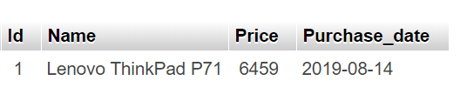
Output :
Record inserted successfully into Laptop table
MySQL connection is closed
MySQL table after inserting the first row from Python

Slide 28
import mysql.connector
from mysql.connector import Error
try:
connection = mysql.connector.connect(host='localhost',
database='Electronics',
user='pynative',
password='pynative@#29')
mySql_insert_query = """INSERT INTO Laptop (Id, Name, Price, Purchase_date)
VALUES (%s, %s, %s, %s) """
records_to_insert = [(4, 'HP Pavilion Power', 1999, '2019-01-11'),
(5, 'MSI WS75 9TL-496', 5799, '2019-02-27'),
(6, 'Microsoft Surface', 2330, '2019-07-23')]

Slide 29
cursor = connection.cursor()
cursor.executemany(mySql_insert_query, records_to_insert)
connection.commit()
print(cursor.rowcount, "Record inserted successfully into Laptop table")
except mysql.connector.Error as error:
print("Failed to insert record into MySQL table {}".format(error))
finally:
if (connection.is_connected()):
cursor.close()
connection.close()
print("MySQL connection is closed")

Slide 30
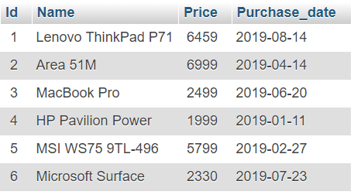
Output:
3 Record inserted successfully into Laptop table
MySQL connection is closed

Slide 31
Select from MySQL Table :
we are fetching all the rows from the Laptop table and copying it into python variables so we can use it in our program.

Slide 32
import mysql.connector
from mysql.connector import Error
try:
connection = mysql.connector.connect(host='localhost',
database='Electronics',
user='root',
password=' ')
sql_select_Query = "select * from Laptop"
cursor = connection.cursor()
cursor.execute(sql_select_Query)
records = cursor.fetchall()
print("Total number of rows in Laptop is: ", cursor.rowcount)

Slide 33
print("\nPrinting each laptop record")
for row in records:
print("Id = ", row[0], )
print("Name = ", row[1])
print("Price = ", row[2])
print("Purchase date = ", row[3], "\n")
except Error as e:
print("Error reading data from MySQL table", e)
finally:
if (connection.is_connected()):
connection.close()
cursor.close()
print("MySQL connection is closed")

Slide 34
OUTPUT :
Total number of rows in Laptop is: 7
Printing each laptop record
Id = 1
Name = Lenovo ThinkPad P71
Price = 6459.0
Purchase date = 2019-08-14
Id = 2
Name = Area 51M
Price = 6999.0
Purchase date = 2019-04-14
Id = 3
Name = MacBook Pro
Price = 2499.0
Purchase date = 2019-06-20
Id = 4
Name = HP Pavilion Power
Price = 1999.0
Purchase date = 2019-01-11

Slide 35
Id = 5
Name = MSI WS75 9TL-496
Price = 5799.0
Purchase date = 2019-02-27
Id = 6
Name = Microsoft Surface
Price = 2330.0
Purchase date = 2019-07-23
Id = 7
Name = Acer Predator Triton
Price = 2435.0
Purchase date = 2019-08-15
MySQL connection is closed

Slide 36
Understand Python MySQL Select query program
import mysql.connector this line imports the MySQL Connector Python module in your program so you can use the methods of this module to communicate with the MySQL database.
Next, We used the mysql.connector.connect() methods to connect the MySQL Database from Python.
Then, We prepared SQL SELECT query to fetch all rows from a Laptop table. This table contains four columns.

Slide 37
Next, we used a connection.cursor methods to get a cursor object from the connection object.
We executed the select operation using a execute() method of a Cursor object.
On successful execution of a select query, the execute() method returns a ResultSet object which contains all the rows. After that, We are using a cursor.fetchall() method we can fetch all the records present under a “Laptop” table.
In the end, we used for loop to iterate over all the records present in the resultset object and printed them one by one.
Once all record fetched successfully, we closed the MySQL Cursor object using a cursor.close() and MySQL database connection using the mySQLconnection.close().

Slide 38
Note: To fetch data use cursor.execute() to run a query.
cursor.fetchall() to fetch all rows
cursor.fetchone() to fetch single row
cursor.fetchmany(SIZE) to fetch limited rows

Slide 39
Update MySQL Table :
we are updating a Laptop table by changing the value of the Price column of the laptop whose id is 1.
import mysql.connector
import mysql.connector
from mysql.connector import Error
try:
connection = mysql.connector.connect(host='localhost',
database='electronics',
user='root',
password=' ')
cursor = connection.cursor()

Slide 40
print("Before updating a record ")
sql_select_query = """select * from Laptop where id = 1"""
cursor.execute(sql_select_query)
record = cursor.fetchone()
print(record)
# Update single record now
sql_update_query = """Update Laptop set Price = 7000 where id = 1"""
cursor.execute(sql_update_query)
connection.commit()
print("Record Updated successfully ")

Slide 41
print("After updating record ")
cursor.execute(sql_select_query)
record = cursor.fetchone()
print(record)
except mysql.connector.Error as error:
print("Failed to update table record: {}".format(error))
finally:
if (connection.is_connected()):
connection.close()
print("MySQL connection is closed")

Slide 42
Output :
Before updating a record
(1, 'Lenovo ThinkPad P71', 6459.0, datetime.date(2019, 8, 14))
Record Updated successfully
After updating record
(1, 'Lenovo ThinkPad P71', 7000.0, datetime.date(2019, 8, 14))
MySQL connection is closed

Slide 43
Let’s Understand the above Script :
import mysql.connector this line imports MySQL Connector Python module in your program so you can use this modules API to connect MySQL
Next, We used the mysql.connector.connect() method to connect the MySQL Database from Python.
Then we prepared SQL UPDATE query to update a “Price” column of a Laptop table. The update query contains the column value to be updated.
we used a connection.cursor() method to get cursor object from the connection. this method creates a new MySQLCursor object. using a cursor.execute() we can execute the operation stored in the UPDATE query.

Slide 44
Make changes persistent into a database using connection.commit().
After a successful update operation, use a cursor.rowcount method to get the number of rows affected. here it will return 1 because we are updating one row.

Slide 45
Delete data from MySQL Table :
In this example, we are deleting a single row from the “Laptop” table.
import mysql.connector
from mysql.connector import Error
try:
connection = mysql.connector.connect(host='localhost',
database='electronics',
user='root',
password=' ')
cursor = connection.cursor()
print("Displaying laptop record Before Deleting it")
sql_select_query = """select * from Laptop where id = 7"""
cursor.execute(sql_select_query)
record = cursor.fetchone()
print(record)

Slide 46
sql_Delete_query = """Delete from Laptop where id = 7"""
cursor.execute(sql_Delete_query)
connection.commit()
cursor.execute(sql_select_query)
records = cursor.fetchall()
if len(records) == 0:
print("\nRecord Deleted successfully ")
except mysql.connector.Error as error:
print("Failed to delete record from table: {}".format(error))
finally:
if (connection.is_connected()):
cursor.close()
connection.close()
print("MySQL connection is closed")

Slide 47
Output :
Displaying laptop record Before Deleting it
(7, 'Acer Predator Triton', 2435.0, datetime.date(2019, 8, 17))
Record Deleted successfully
MySQL connection is closed

Slide 48
Understand Python MySQL Delete row program
import mysql.connector this line imports the MySQL Connector Python module in your program so you can use this module API to connect MySQL.
Next, We used the mysql.connector.connect() method to connect the MySQL database from Python.
Then we prepared the SQL DELETE query to delete a single row from the “Laptop” table. Delete query contains the row to be deleted based on a condition placed in where clause of a query.
Next, We used a connection.cursor method to get cursor object from the connection.

Slide 49
Using a cursor.execute()method we can execute SQL queries.
After a successful Delete operation, execute() method return us the number of rows affected. In this case, we got 1 because we are deleting one row.
Once the record deleted successfully, we need to commit our changes to the database using a connection.commit().
In the end, close MySQL Cursor object using a cursor.close() method and MySQL database connection using a connection.close method.

Slide 50
COMPLETED

